Slide 1
Session 3
Data Preprocessing

Slide 2
Agenda
Data Preprocessing
Feature engineering
Date and Time features
String operations
Fearture transformation
What is data cleaning
Working with missing data
Common mistakes
Working with categorical data
Dealing with outliers
Feature scaling
Dealing with imbalanced classes
Splitting data into training and testing

Slide 3
Data Preprocessing
Data preprocessing is the process of transforming raw data into an understandable format.
Data gathering methods are often loosely controlled, resulting in out-of-range values, useless features, outliers, missing values, etc.
Garbage data produce misleading results. Thus, data preprocessing is the most important phase of a machine learning project

Slide 4

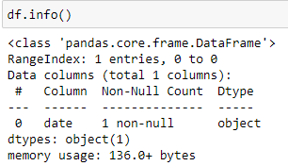
Feature Engineering
Date columns usually provide valuable information about the problem, they are neglected as input for machine learning algorithms. This mainly is because they are saved in string format, making it hard to understand by machine learning algorithms
Column type is string not date time

Slide 5
Feature Engineering
How to change string column to date time?

Slide 6
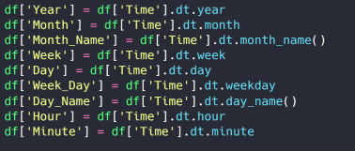
Feature Engineering
Now that the column type is date time, I can do all the following operations

Slide 7
Feature Transformation
Data cleaning is the process of preparing data for analysis by removing or modifying data that is incorrect, incomplete, irrelevant, duplicated, or improperly formatted.
It’s said that the majority of a data scientist's time is spent on cleaning, rather than machine learning. In fact, 45% of data scientist's time is spent on preparing data.
Data cleaning is a lot of muscle work. There’s a reason data cleaning is the most important step if you want to create a data-culture, let alone make airtight predictions. It involves:
Fixing spelling and syntax errors
Standardizing data sets
Correcting mistakes such as empty fields
Identifying duplicate data points

Slide 8

Feature Transformation: Missing Data
Missing Data:
Drop missing data
Fill missing data
Check if there actually is some missing data

Slide 9

Feature Transformation: Missing Data
Missing Data:
Drop missing data
Fill missing data
Drop said columns

Slide 10
Feature Transformation: Missing Data
Missing Data:
Drop missing data
Fill missing data
Fill missing spaces with mean

Slide 11

Feature Transformation: Common mistakes
Height column has 0
Weight is negative
Just drop any illogical data

Slide 12
Feature Transformation: Working With Categorical Data
One hot encoding:
One Hot Encoding is a common way of preprocessing categorical features for machine learning models.
a machine can only understand numbers and cannot understand the text
One hot encoding can be defined as the essential process of converting the categorical data variables to be provided to machine and deep learning algorithms which in turn improve predictions as well as classification accuracy of a model.

Slide 13
Feature Transformation: Working With Categorical Data
One hot encoding:
This type of encoding creates a new binary feature for each possible category and assigns a value of 1 to the feature of each sample that corresponds to its original category.

Slide 14
Feature Transformation: Dealing With Outliers
One hot encoding using get_dummies

Slide 15
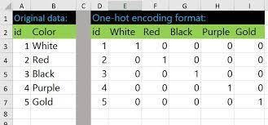

Feature Transformation: Working With Categorical Data
One hot encoding using get_dummies

Slide 16
Feature Transformation: Dealing With Outliers
An outlier is a data point in a data set that is distant from all other observations. A data point that lies outside the overall distribution of the dataset.
Impact of outliers:
skew the data,
significant impact on mean
significant impact on standard deviation.
How to identify outliers:
using scatter plots
using Z score
using the IQR interquartile range

Slide 17
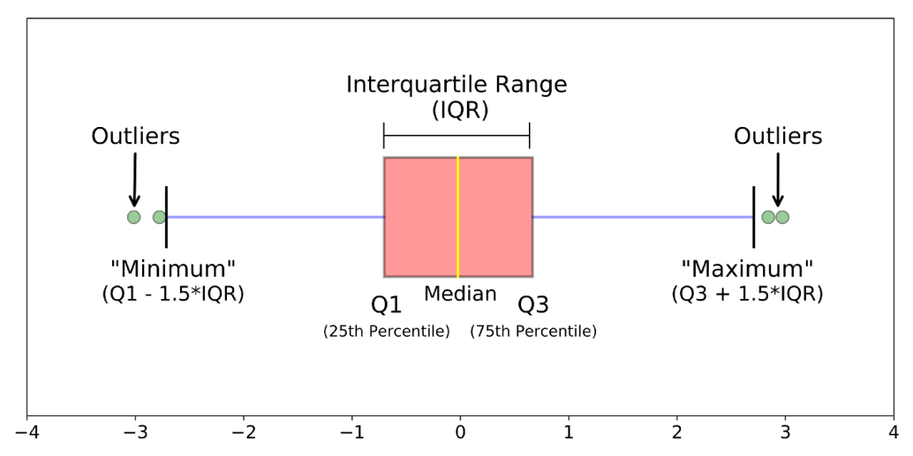
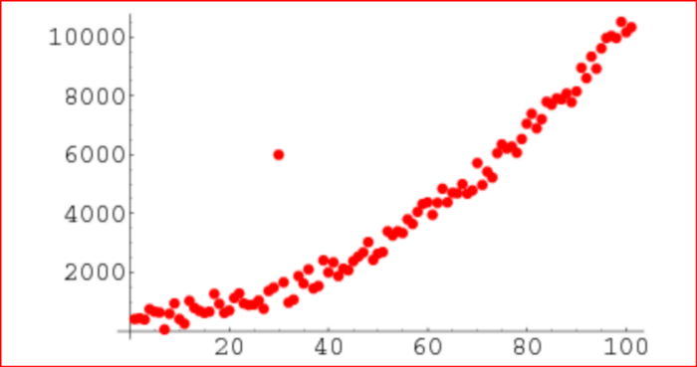
Feature Transformation: Dealing With Outliers

Slide 18
Feature Transformation: Training, Testing & Validation
Train-Valid-Test split is a technique to evaluate the performance of your machine learning model — classification or regression alike. You take a given dataset and divide it into three subsets.

Slide 19
Feature Transformation: Training, Testing & Validation
Train Dataset
Set of data used for learning (by the model), that is, to fit the parameters to the machine learning model

Slide 20
Feature Transformation: Training, Testing & Validation
Valid Dataset
Set of data used to provide an unbiased evaluation of a model fitted on the training dataset while tuning model hyperparameters.
Also play a role in other forms of model preparation, such as feature selection, threshold cut-off selection.

Slide 21
Feature Transformation: Training, Testing & Validation
Test Dataset
Set of data used to provide an unbiased evaluation of a final model fitted on the training dataset.

Slide 22
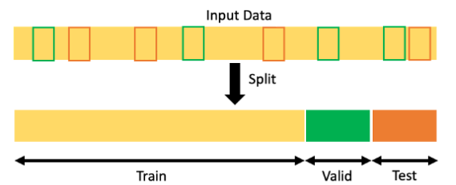
Feature Transformation: Training, Testing & Validation
The usual split is 60%, 20%, 20%

Slide 23
Feature Transformation: Training, Testing & Validation
How to split data in python

Slide 24
Feature Transformation: Feature scaling
Say we have the following 2 features in our data
Kms driven
0
100000
Age
0
100

Slide 25
Feature Transformation: Feature scaling
As seen multiple features can have multiple scales. Thus confusing the model and reducing its accuracy.
The solution is to perform feature scaling or standardization to all numerical features in data.

Slide 26
Feature Transformation: Feature scaling
How do we standardize data?
Kms driven
0
1
Age
0
1

Slide 27
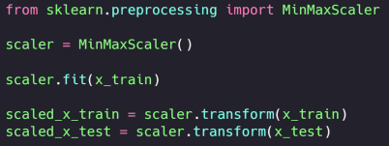
Feature Transformation: Feature scaling
How do we standardize data?

